Slide 1
Data Processing and Analytics
Jason Morris
Solutions Architect

Slide 2
Agenda Overview
10:00 AM Registration
10:30 AM Introduction to Big Data @ AWS
12:00 PM Lunch + Registration for Technical Sessions
12:30 PM Data Collection and Storage
1:45PM Real-time Event Processing
3:00PM Analytics (incl Machine Learning)
4:30 PM Open Q&A Roundtable

Slide 3


Primitive Patterns
Collect
Process
Analyze
Store
Data Collection
and Storage
Event
Processing
Data
Processing
Data
Analysis
EMR
Redshift
Machine
Learning

Slide 4
Amazon Elastic MapReduce (EMR)

Slide 5






Why Amazon EMR?
Easy to Use
Launch a cluster in minutes
Low Cost
Pay an hourly rate
Elastic
Easily add or remove capacity
Reliable
Spend less time monitoring
Secure
Manage firewalls
Flexible
Control the cluster
Notes:
Six main reasons why Amazon EMR

Slide 6



















The Hadoop ecosystem can run in Amazon EMR
Notes:
Amazon EMR is more than just MapReduce.
Bootstrap actions available on GitHub

Slide 7
Choose your instance types
Try different configurations to find your optimal architecture
General
m1 family
m3 family
CPU
c3 family
cc1.4xlarge
cc2.8xlarge
Memory
m2 family
r3 family
Disk/IO
d2 family
i2 family
Batch Machine Spark and Large
process learning interactive HDFS

Slide 8

Resizable clusters
Easy to add/remove compute capacity to your cluster
Match compute demands with cluster sizing

Slide 9
Easy to use Spot Instances
Meet SLA at predictable cost
Exceed SLA at lower cost
On-demand for core nodes
Standard Amazon EC2 pricing for on-demand capacity
Spot Instances for task nodes
Up to 90% off Amazon EC2 on-demand pricing

Slide 10

Amazon S3 as your persistent data store
Separate compute and storage
Resize and shut down Amazon EMR clusters with no data loss
Point multiple Amazon EMR clusters at same data in Amazon S3
EMR
Amazon S3
EMR
Notes:
In the next few slides, we’ll talk about data persistence models with Amazon EMR. The first pattern is Amazon S3 as HDFS. With this data persistence model, data gets stored on Amazon S3. HDFS does not play any role in storing data. As a matter of fact, HDFS is only there for temporary storage. Another common thing I hear is that storing data on Amazon S3 instead of HDFS slows my job down a lot because data has to get copied to the HDFS/disk first before processing starts. That’s incorrect. If you tell Hadoop that your data is on Amazon S3, Hadoop reads directly from Amazon S3 and streams data to Mappers without toughing the disk. Not to be completely correct, data does touch HDFS when data has to shuffle from mappers to reducers, but as I mentioned, HDFS acts as the temp space and nothing more.
EMRFS is an implementation of HDFS used for reading and writing regular files from Amazon EMR directly to Amazon S3. EMRFS provides the convenience of storing persistent data in Amazon S3 for use with Hadoop while also providing features like Amazon S3 server-side encryption, read-after-write consistency, and list consistency.

Slide 11
EMRFS makes it easier to leverage S3
Better performance and error handling options
Transparent to applications – Use “s3://”
Consistent view
For consistent list and read-after-write for new puts
Support for Amazon S3 server-side and client-side encryption
Faster listing using EMRFS metadata
Notes:
And every other feature that comes with Amazon S3. Features such as SSE, LifeCycle, etc. And again keep in mind that Amazon S3 as the storage is the main reason why we can’t build elastic clusters where nodes get added and removed dynamically without any data loss.

Slide 12


Fast listing of S3 objects using EMRFS metadata
List and read-after-write consistency
Faster list operations
Number of objects | Without Consistent Views | With Consistent Views
1,000,000 | 147.72 | 29.70
100,000 | 12.70 | 3.69
*Tested using a single node cluster with a m3.xlarge instance.
Amazon S3
EMRFS metadata in Amazon DynamoDB
Notes:
In the next few slides, we’ll talk about data persistence models with EMR. The first pattern is Amazon S3 as HDFS. With this data persistence model, data gets stored on Amazon S3. HDFS does not play any role in storing data. As a matter of fact, HDFS is only there for temporary storage. Another common thing I hear is that storing data on Amazon S3 instead of HDFS slows my job down a lot because data has to get copied to HDFS/disk first before processing starts. That’s incorrect. If you tell Hadoop that your data is on Amazon S3, Hadoop reads directly from Amazon S3 and streams data to Mappers without toughing the disk. Not to be completely correct, data does touch HDFS when data has to shuffle from mappers to reducers, but as I mentioned, HDFS acts as the temp space and nothing more.
EMRFS is an implementation of HDFS used for reading and writing regular files from Amazon EMR directly to Amazon S3. EMRFS provides the convenience of storing persistent data in Amazon S3 for use with Hadoop while also providing features like Amazon S3 server-side encryption, read-after-write consistency, and list consistency.

Slide 13

EMRFS - S3 client-side encryption
(client-side encrypted objects)
Amazon S3
Amazon S3 encryption clients
EMRFS enabled for Amazon S3 client-side encryption
Key vendor (AWS KMS or your custom key vendor)
Notes:
In the next few slides, we’ll talk about data persistence models with EMR. The first pattern is Amazon S3 as HDFS. With this data persistence model, data gets stored on Amazon S3. HDFS does not play any role in storing data. As a matter of fact, HDFS is only there for temporary storage. Another common thing I hear is that storing data on Amazon S3 instead of HDFS slows my job down a lot because data has to get copied to HDFS/disk first before processing starts. That’s incorrect. If you tell Hadoop that your data is on Amazon S3, Hadoop reads directly from Amazon S3 and streams data to Mappers without toughing the disk. Not to be completely correct, data does touch HDFS when data has to shuffle from mappers to reducers, but as I mentioned, HDFS acts as the temp space and nothing more.
EMRFS is an implementation of HDFS used for reading and writing regular files from Amazon EMR directly to Amazon S3. EMRFS provides the convenience of storing persistent data in Amazon S3 for use with Hadoop while also providing features like Amazon S3 server-side encryption, read-after-write consistency, and list consistency.

Slide 14
Optimize to leverage HDFS
Iterative workloads
If you’re processing the same dataset more than once
Disk I/O intensive workloads
Persist data on Amazon S3 and use S3DistCp to copy to HDFS for processing

Slide 15

Pattern #1: Batch processing
GBs of logs pushed to Amazon S3 hourly
Input and output stored in Amazon S3
Daily Amazon EMR cluster using Hive to process data
Load subset into Redshift DW

Slide 16

Pattern #2: Online data-store
Data pushed to Amazon S3
Daily Amazon EMR cluster Extract, Transform, and Load (ETL) data into database
24/7 Amazon EMR cluster running HBase holds last 2 years’ worth of data
Front-end service uses HBase cluster to power dashboard with high concurrency

Slide 17





Pattern #3: Interactive query
TBs of logs sent daily
Logs stored in S3
Hive Metastore
Transient EMR clusters
Notes:
EMR example #3: EMR for ETL and query engine for investigations which require all raw data

Slide 18


Example: Log Processing using Amazon EMR
Aggregating small files using s3distcp
Defining Hive tables with data on Amazon S3
Interactive querying using Hue
Amazon S3
Log Bucket
Amazon
EMR
Processed and structured log data
Notes:
CloudFront logs arrive out of order.

Slide 19

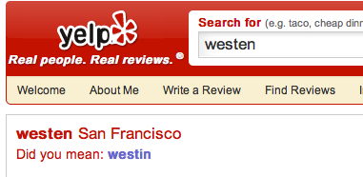

Data Analyzed Using EMR:
Automatic spelling corrections
Months of user history
Common misspellings
Westen
Wistin
Westan
Whestin
Notes:
200 node cluster
spin it up daily, shut it down

Slide 20
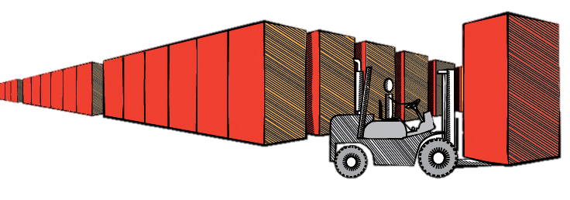
Amazon Redshift
Fast, simple, petabyte-scale data warehousing for less than $1,000/TB/Year

Slide 21




































Selected Amazon Redshift Customers
Notes:
Nasdaq security, HasOffers loads 60M rows per day in 2 min intervals, Desk: high concurrency user facing portal (read/write cluster), Amazon.com/NTT PB scale. Pinterest saw 50-100x speed ups when moved 300TB from Hadoop to Redshift. Nokia saw 50% reduction in costs.

Slide 22

Clickstream Analysis for Amazon.com
Redshift runs web log analysis for Amazon.com
100 node Redshift Cluster
Over one petabyte workload
Largest table: 400TB
2TB of data per day
Understand customer behavior
Who is browsing but not buying
Which products / features are winners
What sequence led to higher customer conversion
Notes:
Today we will over the role of Amazon Redshift in addressing the Web Log Analysis problem for one of the largest online retailer, Amazon.com
<go over the slide with restated language>

Slide 23
Redshift Performance Realized
Scan 15 months of data: 14 minutes
2.25 trillion rows
Load one day worth of data: 10 minutes
5 billion rows
Backfill one month of data: 9.75 hours
150 billion rows
Pig → Amazon Redshift: 2 days to 1 hr
10B row join with 700M rows
Oracle → Amazon Redshift: 90 hours to 8 hrs
Reduced number of SQLs by a factor of 3

Slide 24
Amazon Redshift Architecture
Leader Node
SQL endpoint
Stores metadata
Coordinates query execution
Compute Nodes
Local, columnar storage
Execute queries in parallel
Load, backup, restore via Amazon S3; load from Amazon DynamoDB or SSH
Two hardware platforms
Optimized for data processing
DW1: HDD; scale from 2TB to 2PB
DW2: SSD; scale from 160GB to 325TB
SQL Clients/BI Tools
JDBC/ODBC
Leader Node
128GB RAM
16 cores
16TB disk
10 GigE
(HPC)
Compute Node
Compute Node
Compute Node
128GB RAM
128GB RAM
128GB RAM
16 cores
16 cores
16 cores
16TB disk
16TB disk
16TB disk
Ingestion
Backup
Restore
Amazon S3 / DynamoDB / SSH

Slide 25
Amazon Redshift Node Types
DW1.XL: 16 GB RAM, 2 Cores 3 Spindles, 2 TB compressed storage
DW1.8XL: 128 GB RAM, 16 Cores, 24 Spindles 16 TB compressed, 2 GB/sec scan rate
Optimized for I/O intensive workloads
High disk density
On demand at $0.85/hour
As low as $1,000/TB/Year
Scale from 2TB to 1.6PB
DW2.L: 16 GB RAM, 2 Cores, 160 GB compressed SSD storage
DW2.8XL: 256 GB RAM, 32 Cores, 2.56 TB of compressed SSD storage
High performance at smaller storage size
High compute and memory density
On demand at $0.25/hour
As low as $5,500/TB/Year
Scale from 160GB to 256TB

Slide 26
Amazon Redshift dramatically reduces I/O
ID | Age | State | Amount
123 | 20 | CA | 500
345 | 25 | WA | 250
678 | 40 | FL | 125
957 | 37 | WA | 375
Column storage
Data compression
Zone maps
Direct-attached storage
With row storage you do unnecessary I/O
To get total amount, you have to read everything
Notes:
Read only the data you need

Slide 27
Amazon Redshift dramatically reduces I/O
ID | Age | State | Amount
123 | 20 | CA | 500
345 | 25 | WA | 250
678 | 40 | FL | 125
957 | 37 | WA | 375
Column storage
Data compression
Zone maps
Direct-attached storage
With column storage, you only read the data you need
Notes:
Read only the data you need

Slide 28
Amazon Redshift dramatically reduces I/O
analyze compression listing;
Table | Column | Encoding
---------+----------------+----------
listing | listid | delta
listing | sellerid | delta32k
listing | eventid | delta32k
listing | dateid | bytedict
listing | numtickets | bytedict
listing | priceperticket | delta32k
listing | totalprice | mostly32
listing | listtime | raw
Column storage
Data compression
Zone maps
Direct-attached storage
COPY compresses automatically
You can analyze and override
More performance, less cost
Notes:
Read only the data you need

Slide 29
Amazon Redshift dramatically reduces I/O
10
Column storage
Data compression
Zone maps
Direct-attached storage
10 | 13 | 14 | 26 |…
… | 100 | 245 | 324
324
375
375 | 393 | 417…
… 512 | 549 | 623
623
637
637 | 712 | 809 …
… | 834 | 921 | 959
959
Track the minimum and maximum value for each block
Skip over blocks that don’t contain relevant data
Notes:
Read only the data you need

Slide 30
Amazon Redshift dramatically reduces I/O
Use local storage for performance
Maximize scan rates
Automatic replication and continuous backup
HDD & SSD platforms
Column storage
Data compression
Zone maps
Direct-attached storage
Notes:
Read only the data you need

Slide 31
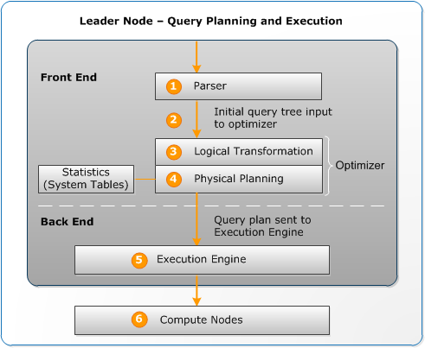
Amazon Redshift parallelizes and distributes everything
Query
Load
Backup/Restore
Resize

Slide 32
Amazon Redshift parallelizes and distributes everything
Query
Load
Backup/Restore
Resize
Compute Node
Compute Node
Compute Node
128GB RAM
128GB RAM
128GB RAM
16 cores
16 cores
16 cores
16TB disk
16TB disk
16TB disk
Amazon S3 / DynamoDB / SSH
Load in parallel from Amazon S3 or DynamoDB or any SSH connection
Data automatically distributed and sorted according to DDL
Scales linearly with the number of nodes in the cluster

Slide 33
Amazon Redshift parallelizes and distributes everything
Query
Load
Backup/Restore
Resize
Compute Node
Compute Node
Compute Node
128GB RAM
128GB RAM
128GB RAM
16 cores
16 cores
16 cores
16TB disk
16TB disk
16TB disk
Amazon S3
Backups to Amazon S3 are automatic, continuous and incremental
Configurable system snapshot retention period. Take user snapshots on-demand
Cross region backups for disaster recovery
Streaming restores enable you to resume querying faster

Slide 34
Amazon Redshift parallelizes and distributes everything
SQL Clients/BI Tools
Query
Load
Backup/Restore
Resize
Leader Node
Leader Node
128GB RAM
128GB RAM
16 cores
16 cores
48TB disk
48TB disk
Compute Node
Compute Node
Compute Node
Compute Node
Compute Node
Compute Node
Compute Node
128GB RAM
128GB RAM
128GB RAM
128GB RAM
128GB RAM
128GB RAM
128GB RAM
16 cores
16 cores
16 cores
16 cores
16 cores
16 cores
16 cores
48TB disk
48TB disk
48TB disk
48TB disk
48TB disk
48TB disk
48TB disk
Resize while remaining online
Provision a new cluster in the background
Copy data in parallel from node to node
Only charged for source cluster

Slide 35
Amazon Redshift parallelizes and distributes everything
Query
Load
Backup/Restore
Resize
SQL Clients/BI Tools
Leader Node
128GB RAM
16 cores
48TB disk
Compute Node
Compute Node
Compute Node
Compute Node
128GB RAM
128GB RAM
128GB RAM
128GB RAM
16 cores
16 cores
16 cores
16 cores
48TB disk
48TB disk
48TB disk
48TB disk
Automatic SQL endpoint switchover via DNS
Decommission the source cluster
Simple operation via Console or API

Slide 36
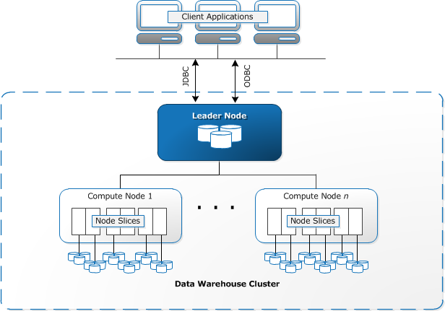
Architecture and its Table Design Implications
Notes:
Comments on next slide.

Slide 37
Table Distribution Styles
Distribution Key
All
Even
Same key to same location
All data on
every node
Round robin
distribution
key1
key2
key3
key4
Node 1
Node 2
Node 1
Node 2
Node 1
Node 2
Slice 1
Slice 2
Slice 3
Slice 4
Slice 1
Slice 2
Slice 3
Slice 4
Slice 1
Slice 2
Slice 3
Slice 4
Notes:
Redshift is a distributed system:
A cluster contains a leader node and compute nodes
A compute node contains slices (one per core) that contain data
Data is distributed among slices in 3 ways:
Even – Rows distributed in Round Robin fashion (default)
Key – Rows distributed based on a distribution key (hash of a defined column)
All - Rows distributed to all slices
Queries run on all slices in parallel
Optimal query throughput can be achieved when data is evenly spread across slices

Slide 38
Sorting Data
In the slices (on disk), the data is sorted by a sort key
If no sort key exists Redshift uses the data insertion order
Choose a sort key that is frequently used in your queries
As a query predicate (date, identifier, …)
As a join parameter (it can also be the hash key)
The sort key allows Redshift to avoid reading entire blocks based on predicates
For example, a table containing a timestamp sort key where only recent data is accessed, will skip blocks containing “old” data
Notes:
Redshift leverages sorting in storage.
Redshift stores column data in blocks, for the sort key, the data blocks are “marked” with the min and max value of this columns, allowing Redshift to skip reading the blocks that are not relevant to the current query.
Check that join parameter statement is true (best practices on designing tables)

Slide 39
Interleaved Multi Column Sort
Compound Sort Keys
Optimized for applications that filter data by one leading column
Interleaved Sort Keys (new)
Optimized for filtering data by up to eight columns
No storage overhead unlike an index
Lower maintenance penalty compared to indexes

Slide 40
Compound Sort Keys Illustrated
cust_id prod_id other columns blocks
1
1
Records in Redshift are stored in blocks.
For this illustration, let’s assume that four records fill a block
Records with a given cust_id are all in one block
However, records with a given prod_id are spread across four blocks
1
2
1
3
1
4
prod_id
cust_id
1 2 3 4
2
1
2
2
[1,1] [1,2] [1,3] [1,4]
[2,1] [2,2] [2,3] [2,4]
[3,1] [3,2] [3,3] [3,4]
[4,1] [4,2] [4,3] [4,4]
2
3
2
4
3
1
3
2
3
3
3
4
4
1
4
2
4
3
4
4

Slide 41
Interleaved Sort Keys Illustrated
cust_id prod_id other columns blocks
1
1
Records with a given cust_id are spread across two blocks
Records with a given prod_id are also spread across two blocks
Data is sorted in equal measures for both keys
1
2
2
1
2
2
prod_id
cust_id
1 2 3 4
1
3
1
4
[1,1] [1,2] [1,3] [1,4]
[2,1] [2,2] [2,3] [2,4]
[3,1] [3,2] [3,3] [3,4]
[4,1] [4,2] [4,3] [4,4]
2
3
2
4
3
1
3
2
4
1
4
2
3
3
3
4
4
3
4
4

Slide 42

















Amazon Redshift works with your existing analysis tools
JDBC/ODBC
Amazon Redshift
Notes:
Redshift works with customer’s BI tool of choice through Postgres drivers and a JDBC, ODBC connection. A number of partners shown here have certified integration with Redshift, meaning they have done testing to validate/build Redshift integration and make using Redshift easy from a UI perspective. If there are tools customer’s use not shown we can work with Redshift on getting them integrated.

Slide 43
Custom ODBC and JDBC Drivers
Up to 35% higher performance than open source drivers
Supported by Informatica, Microstrategy, Pentaho, Qlik, SAS, Tableau, Tibco, and others
Will continue to support PostgreSQL open source drivers
Download drivers from console

Slide 44

User Defined Functions
We’re enabling User Defined Functions (UDFs) so you can add your own
Scalar and Aggregate Functions supported
You’ll be able to write UDFs using Python 2.7
Syntax is largely identical to PostgreSQL UDF Syntax
System and network calls within UDFs are prohibited
Comes with Pandas, NumPy, and SciPy pre-installed
You’ll also be able import your own libraries for even more flexibility

Slide 45






Redshift Use Case
COPY
SQL
Staging
Prod
s3cmd
SELECT
INTO OUTFILE
bcp
SQL Server
Notes:
So, we started with our MySQL server. But this time we would run directly on the server itself SQL statements that would dump the data out to local files. Then using s3cmd we copied the flat files into our S3 bucket.
Select data from MySQL and use the S3cmd to copy these flat files to S3.
Use BCP to export data into an EC2 instance, which generates and copies flat files to S3.
And then instead of using EMR, we just run some crazy SQL statements to transform the data into the Production version of Redshift.
Copy data into a staging schema in Redshift where it can be transformed via SQL to the final table structure and loaded into the production schema.
Use standard tools, like Microstrategy and Tableau, to provide business views into the data.
And then of course we need a good way for business users to look at the data, and that’s where MicroStrategy and Tableau come into play.

Slide 46
Operational Reporting with Redshift
Amazon S3
Log Bucket
Amazon
EMR
Processed and structured log data
Amazon
Redshift
Operational Reports
Notes:
CloudFront logs arrive out of order.

Slide 47

October 6-9, 2015 | The Venetian - Las Vegas, NV
Amazon Web Services’ global
customer and partner conference
Learn more and register:
reinvent.awsevents.com

Slide 48
Thank you Questions?

